Slide 1


Predicting Titanic Survival Rates Alysen Casaccio, RN-BC, BHA, CPHIMS

Slide 2



Agenda
Problem Statement
Data Selection
Data Preparation
Exploratory Data Analysis
Model Building
Redundancy and VIF Testing
Feature Selection
Model Evaluation
Model Comparison
Conclusion
References

Slide 3




Problem Statement
The Titanic Survival Predictor is a machine-learning competition hosted by Kaggle.com.
The project aims to code a machine-learning model that predicts survival outcomes for passengers on the Titanic based on a dataset that provides passenger names, ages, genders, socio-economic class, and other factors.

Slide 4
Data Selection
KEY Features
Context
Pclass: Ticket class as a proxy for socio-economic status.
Sex and Age: Critical demographic indicators of survival likelihood.
Fare and Cabin: Reflected financial status and accommodation details.
Embarked: Point of embarkation offered insights into passenger origin.
Target Variable: Survived (binary classification: 1 = survived, 0 = did not survive.)
Historical Context:
The dataset represents the 891 passengers aboard the Titanic, with features reflecting demographics, socio-economic status, and travel details.

Slide 5
Data Preparation
Feature Engineering
Handling Missing Data
Created new features such as Deck (extracted from Cabin) and Has_Cabin.
Encoded categorical variables (Sex, Embarked, Deck) using label encoding.
Scaled numerical features (Age, Fare) using StandardScaler to normalize their distributions.
Data Splitting: Divided the training data into 80% training and 20% validation sets to evaluate generalization.
Replaced missing Age and Fare values with the median to preserve central tendencies.
Filled missing Cabin values with "Unassigned" and created Has_Cabin as a binary indicator.
Used the mode to fill missing Embarked values

Slide 6
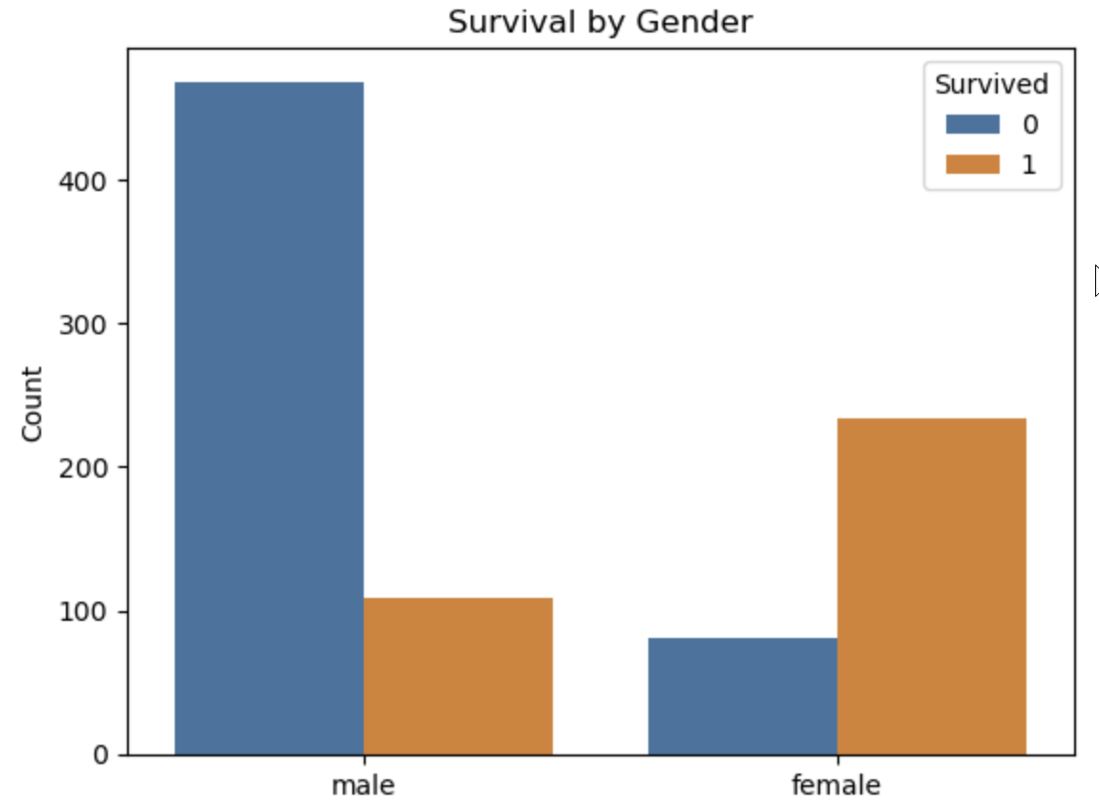
Exploratory Data Analysis
Critical Survival Insights
Females had a higher survival rate

Slide 7
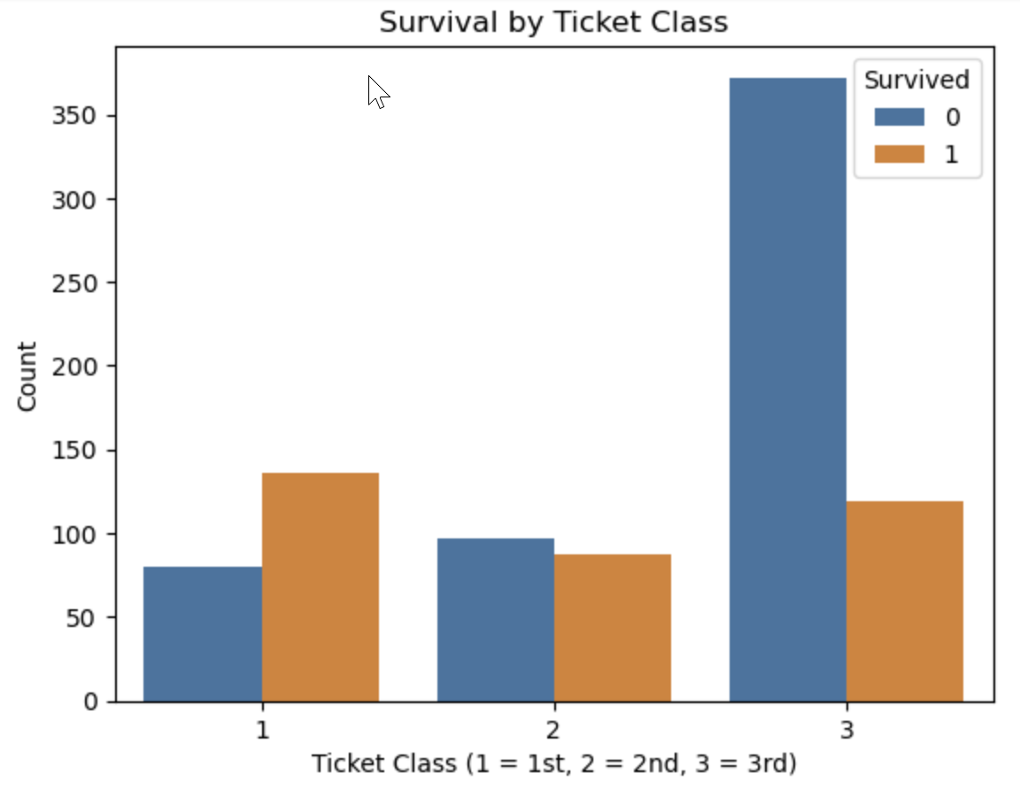
Exploratory Data Analysis
Critical Survival Insights
Passengers in higher socio-economic classes had better survival rates

Slide 8
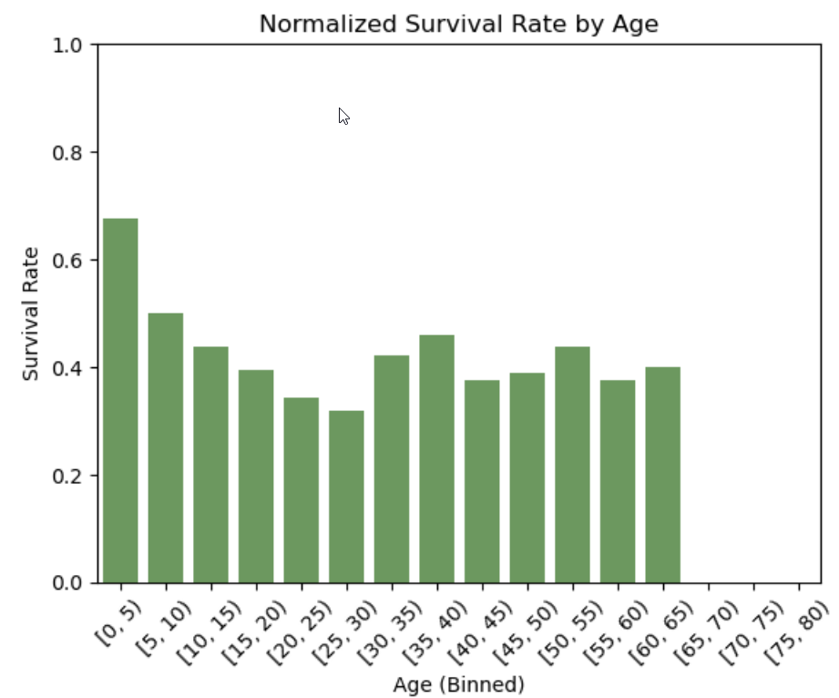
Exploratory Data Analysis
Critical Survival Insights
Younger passengers, particularly children, had better survival rates.

Slide 9

Model Building
Three Comparative Models:
Linear Regression
Random Forest
XGBoost

Slide 10

Redundancy
Before selecting the final features for modeling, a multicollinearity test was performed to check for redundancy.
Notes:
Although Random Forest and XGBoost models would be resilient to multicollinearity, addressing it before modeling ensured I had a clean dataset for all three models.

Slide 11
Variance Inflation Factor (VIF) Testing
Feature | First VIF | VIF After Removal of Deck_Label
Pclass (Purchased Class) | 21.30 | 6.04
Age | 6.65 | 5.21
SibSp (Sibling or Spouse) | 1.57 | 1.57
Parch | 1.61 | 1.61
Fare | 2.16 | 2.03
Sex_Encoded | 1.72 | 1.65
Embarked_Encoded | 5.20 | 4.66
Deck_Label | 31.93 | N/A
Has_Cabin | 3.59 | 2.11

Slide 12

Features Selected for Modeling
Pclass
Age
SibSp
Parch
Fare
Sex_Encoded
Embarked_Encoded
Has_Cabin
Age_Scaled
Fare_Scaled

Slide 13
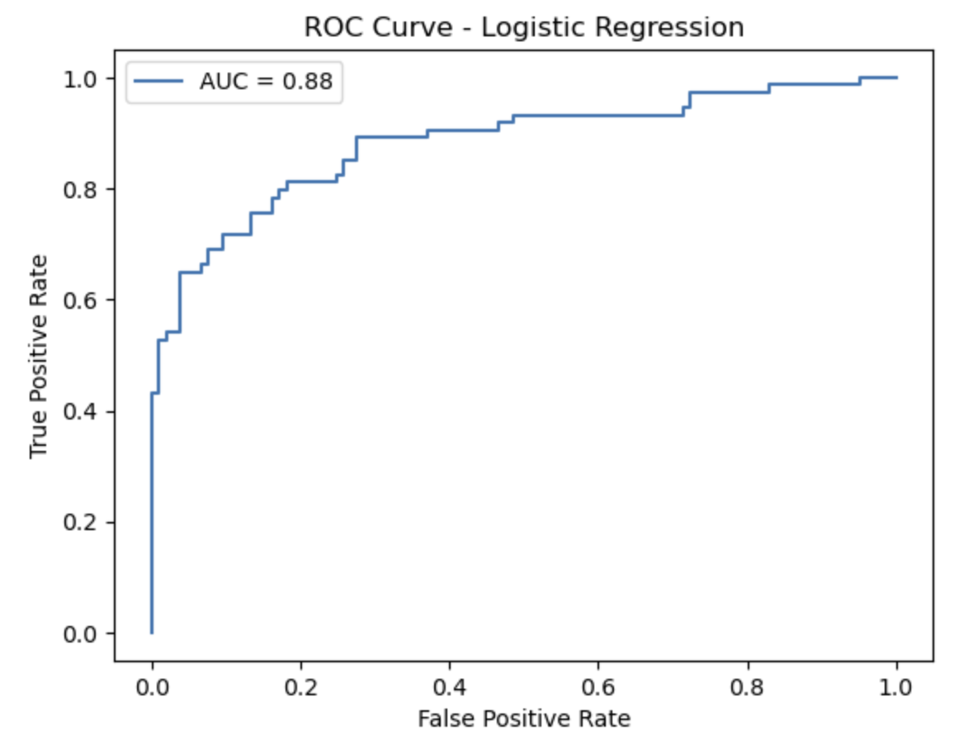
Linear Regression
Results:
Accuracy: 0.82
Precision: 0.80
Recall: 0.76

Slide 14
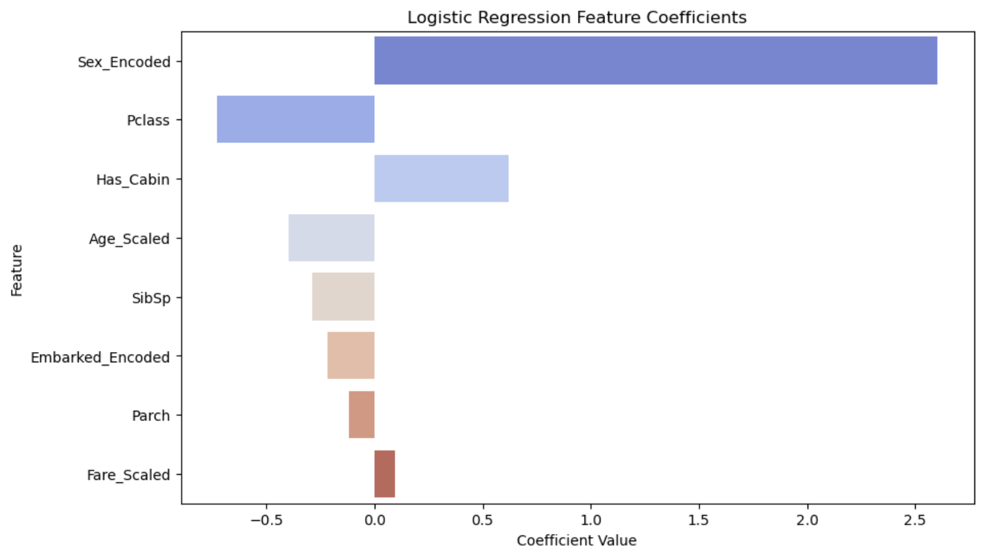
Linear Regression

Slide 15
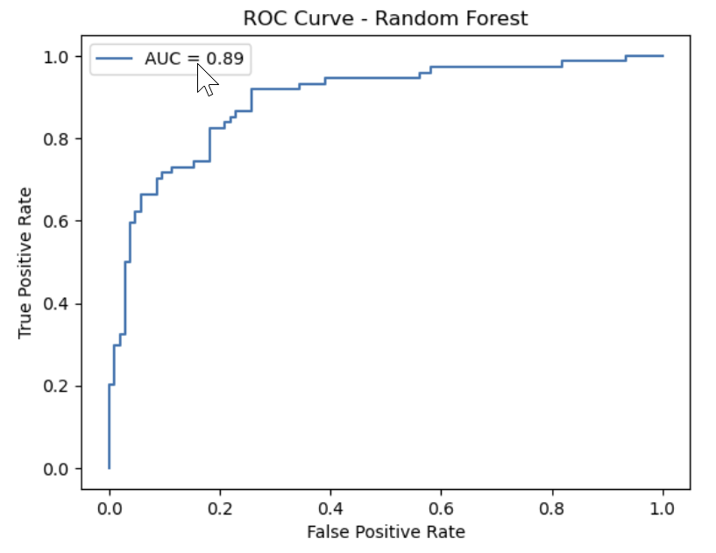
Random Forest
Results:
Accuracy: 0.82
Precision: 0.83
Recall: 0.74

Slide 16
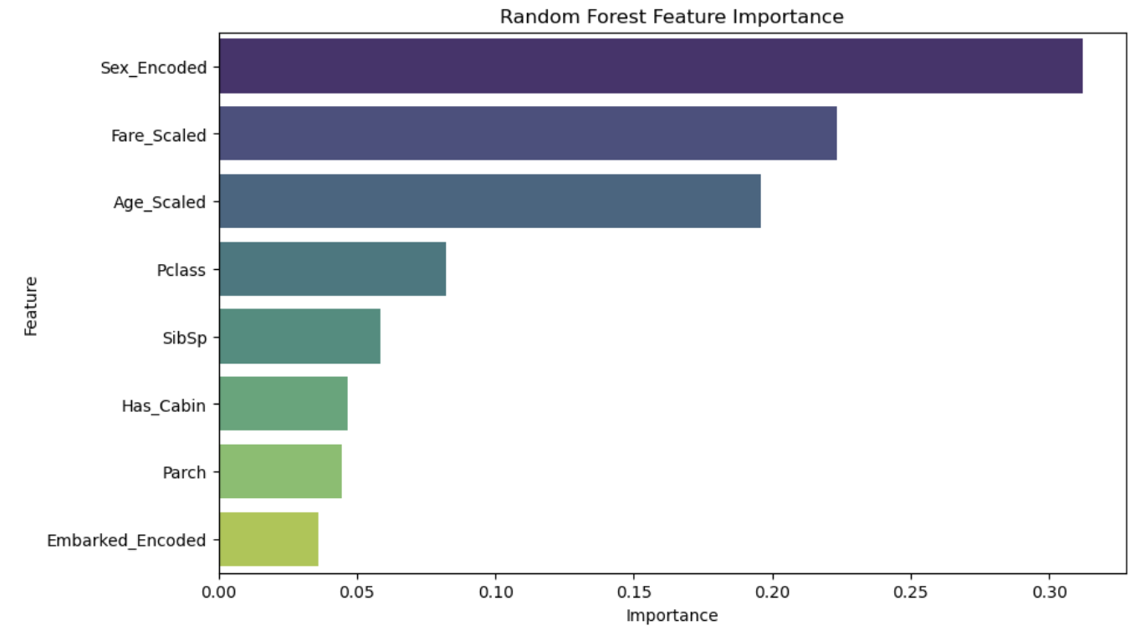
Random Forest

Slide 17
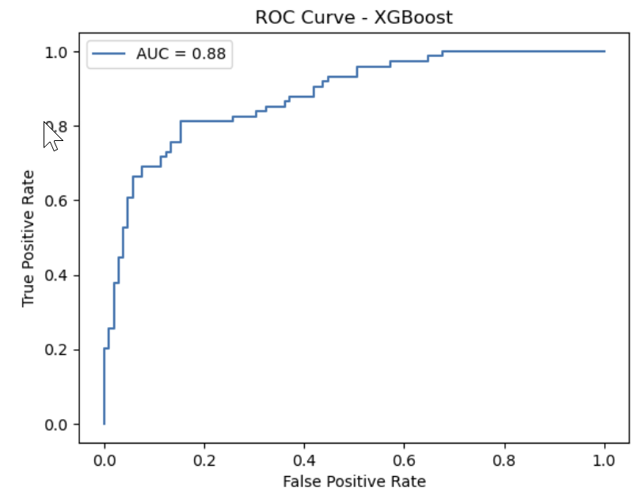
XG Boost
Results:
Accuracy: 0.82
Precision: 0.82
Recall: 0.74

Slide 18
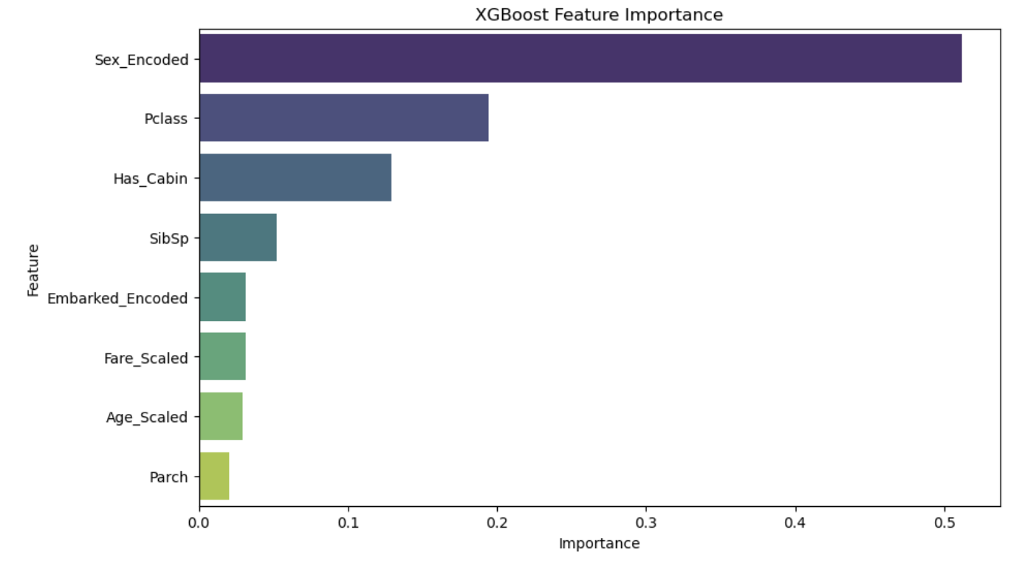
XG Boost

Slide 19
Model Evaluation Comparison
Evaluation Metric | Logistic Regression | Random Forest | XG Boost
Validation Accuracy | 0.82 | 0.82 | 0.82
AUC | 0.88 | 0.88 | 0.89
Precision (Survived) | 0.80 | 0.83 | 0.82
Recall (Survived) | 0.76 | 0.74 | 0.74
F-1 Score (Survived) | 0.78 | 0.78 | 0.77

Slide 20
Conclusion and Summary
The project successfully applied machine-learning techniques to predict Titanic's survival with accuracy and balance.
The consistent performance across models (82% validation accuracy) suggests that the dataset's predictive limit has been reached.
While XGBoost demonstrated slight improvements in AUC, logistic regression remains a compelling choice for simplicity and interpretability.
Future enhancements could explore ensemble methods or advanced feature engineering, though gains may be marginal without additional data.

Slide 21

Thank you
Alysen Casaccio
402-350-3877
alysencasaccio@gmail.com
https://www.linkedin.com/in/alysencasaccio/

